Slide 1
CSC 439 Sprint Week 4
Jacob Moore, Zack Sprague, James Craig, Chris Wells, Joshua McGuire, Reed Inderwiesche

Slide 2
Team Leader: Josh McGuire
<?php $query = mysql_query("select count(*) as total from books"); $result = mysql_fetch_array($query); echo $result['total’]; ?>
Didn’t Work correctly so had to resort to hard coding for now.

Slide 3
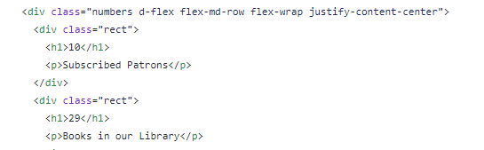
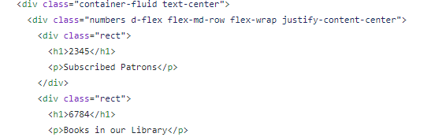

Slide 4
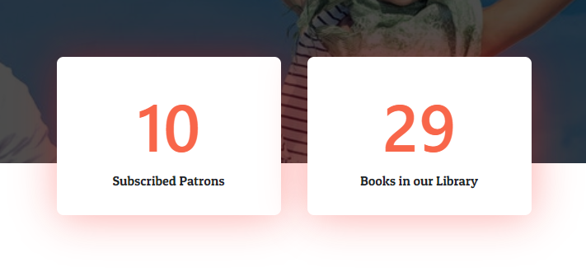

Slide 5
Configuration Manager: Jacob Moore
Tasks:
Style up our books view pages.
Develop some HTML unit testing using JUnit

Slide 6
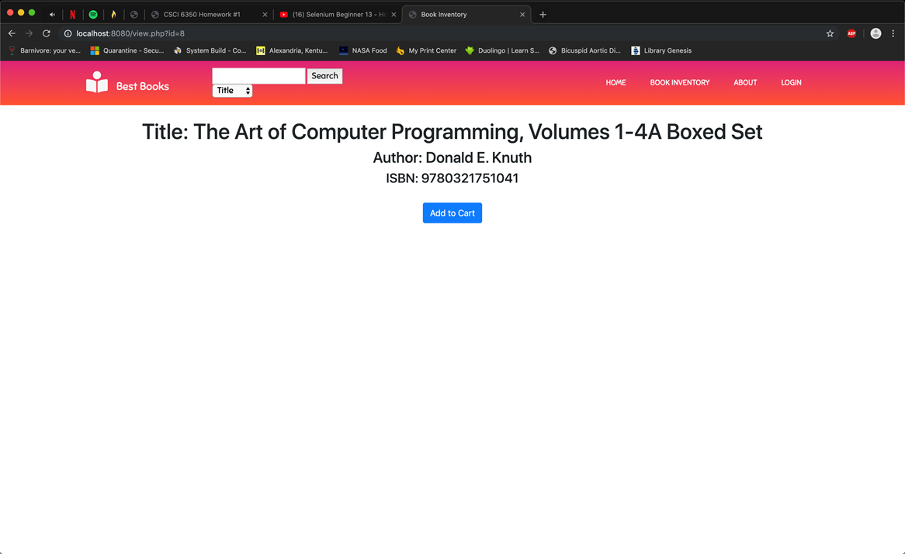
Before:

Slide 7
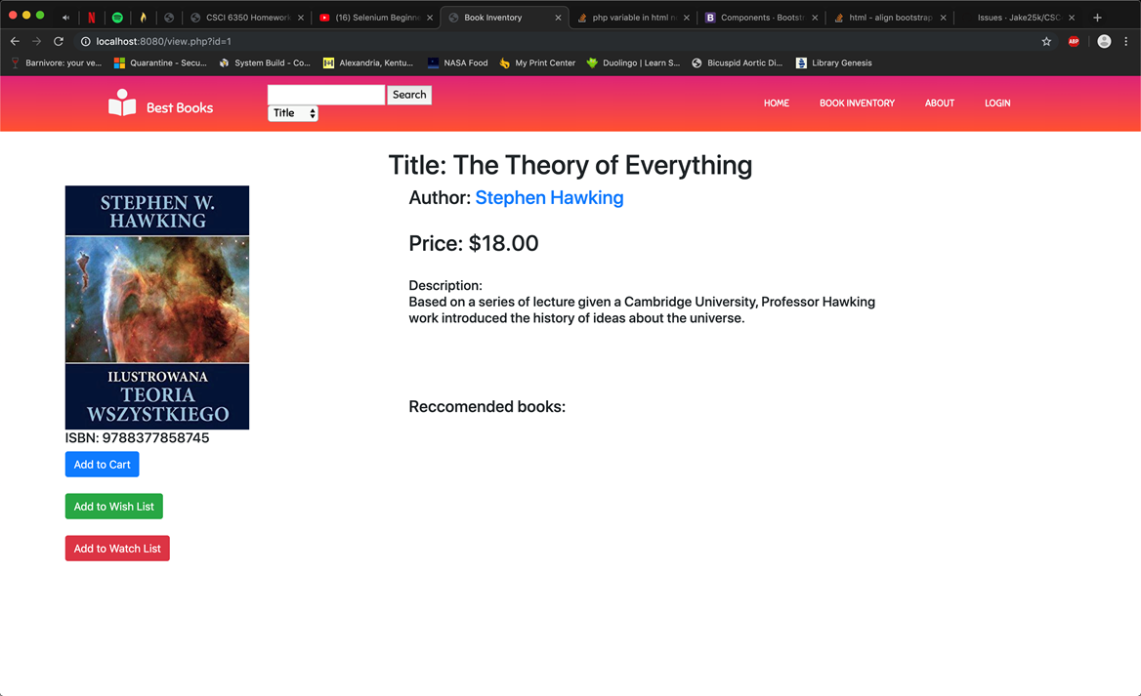
After:

Slide 8
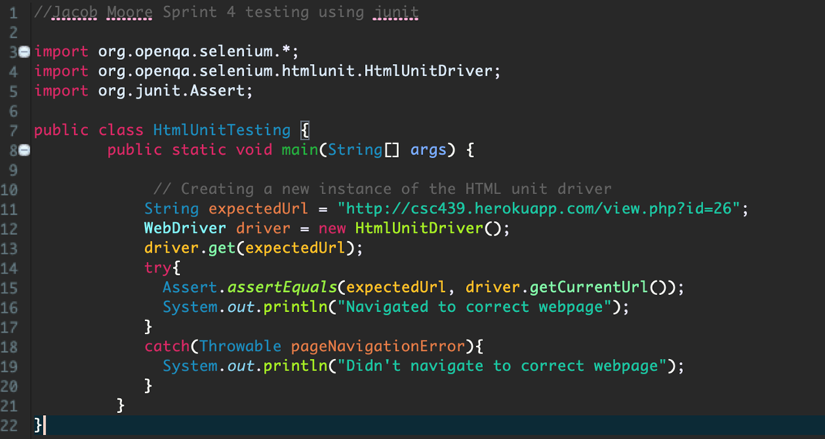

Junit HTML Unit testing

Slide 9
Build Manager: Zach Sprague
Tasks:
1. Made the input boxes sticky for user ease on login and register pages.
2. Removed the error container and made the text fields ”required” which tells the user that there needs to be input. Login success and if user information does not match a message is posted above the form.
4. Made login/logout button. Only works on the login page at the moment.
5. Implement password hashing. PostgreSQL uses pgcrypto.
https://github.com/Jake25k/CSC439/commit/5b141a09d139ae84612b799ea9530b8f5e6db697
https://github.com/Jake25k/CSC439/commit/18a78c8ed7e19dcc8e744f5cc387a5094f54f256

Slide 10
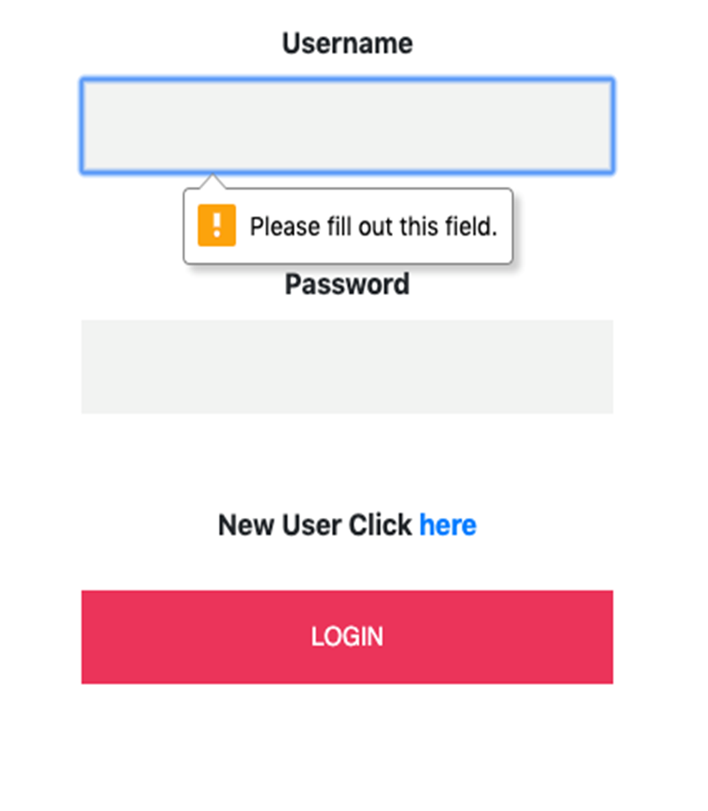
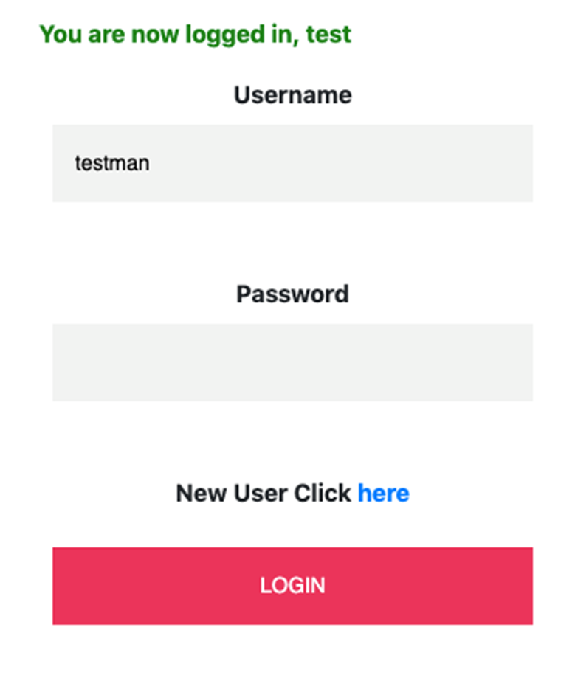

Slide 11
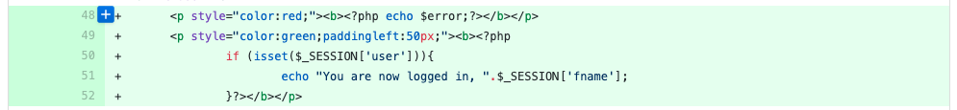
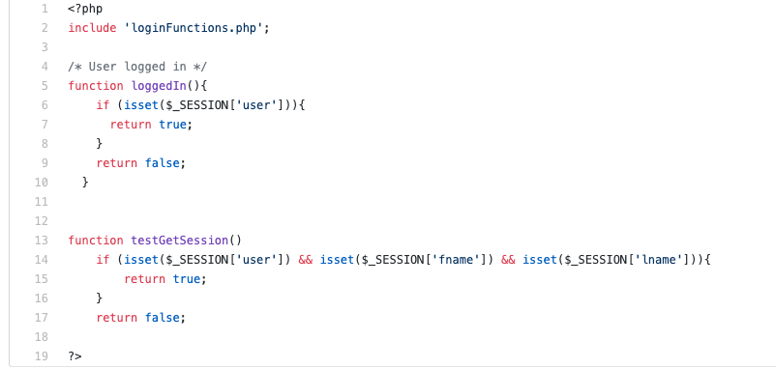

Slide 12
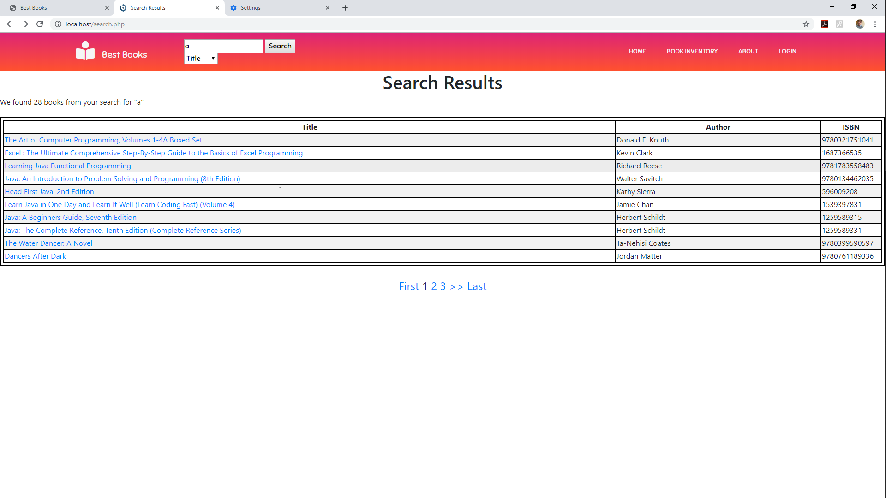
SCM Manager: James Craig
Paging to the search page, not fully functional

Slide 13
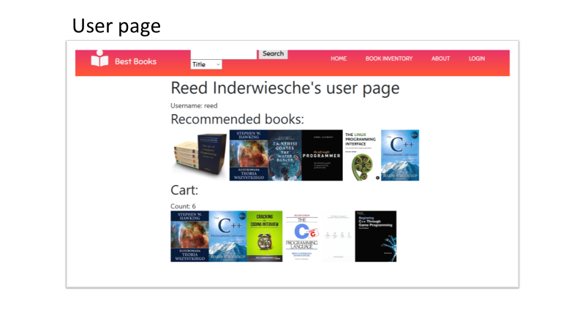
Reed Inderwiesche : Tester

Slide 14
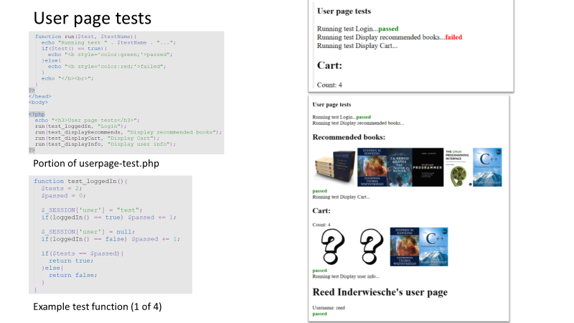

Slide 15
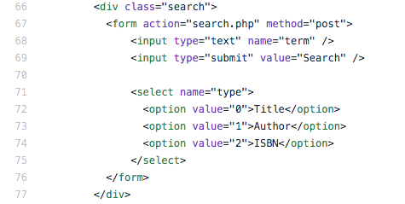
Tester: Chris Wells
Made the search bar retain previous search term and type for user reference.
Before

Slide 16
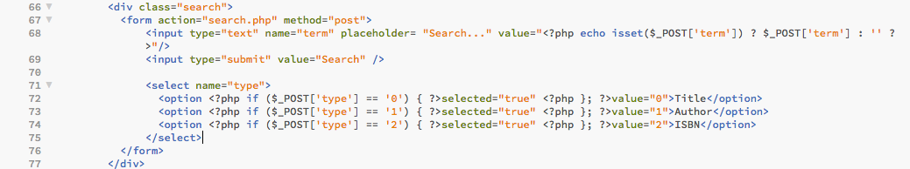
Tester: Chris Wells
Made the search bar retain previous search term and type for user reference.
After

Slide 17
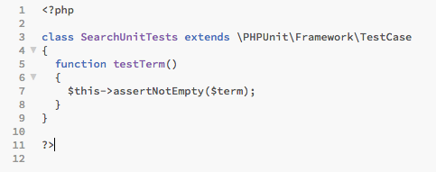
Tester: Chris Wells
Made the search bar retain previous search term and type for user reference.
Unit Test

